Slide 1


Büşra Küden
21.07.2024

Slide 2

Outline
Executive Summary
Introduction
Methodology
Results
Conclusion
Appendix

Slide 3
Executive Summary
Summary of methodologies
Data Collection through API
Data Collection with Web Scraping
Data Wrangling
Exploratory Data Analysis with SQL
Exploratory Data Analysis with Data Visualization
Interactive Visual Analytics with Folium
Machine Learning Prediction
Summary of all results
Exploratory Data Analysis result
Interactive analytics in screenshots
Predictive Analytics result

Slide 4
Introduction
In this project we will predict if the Falcon 9 first stage will land successfully. SpaceX advertises Falcon 9 rocket launches on its website, with a cost of 62 million dollars; other providers cost upward of 165 million dollars each, much of the savings is because SpaceX can reuse the first stage. Therefore, if we can determine if the first stage will land, we can determine the cost of a launch. This information can be used if an alternate company wants to bid against SpaceX for a rocket launch.

Slide 5

Section 1

Slide 6
Methodology
Executive Summary
Data collection methodology:
Data was collected using SpaceX API and web scraping from Wikipedia.
Perform exploratory data analysis (EDA) using visualization and SQL
Perform interactive visual analytics using Folium and Plotly Dash
Perform predictive analysis using classification models
How to build, tune, evaluate classification models

Slide 7
Data Collection
Data sets were collected as follows:
Request and parse the SpaceX launch data using the GET request
Decode the response content as a Json using .json() and turn it into a Pandas dataframe using .json_normalize()
Clean the data, checked for missing values and fill in missing values where necessary.
Perform web scraping from Wikipedia for Falcon 9 launch records with BeautifulSoup.

Slide 8
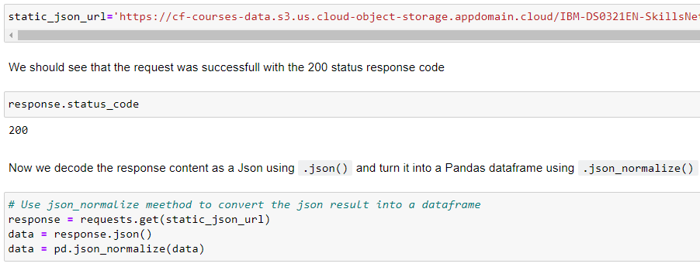
Data Collection – SpaceX API
Request and parse the SpaceX launch data using the GET request
The GitHub URL of the completed SpaceX API calls notebook.

Slide 9
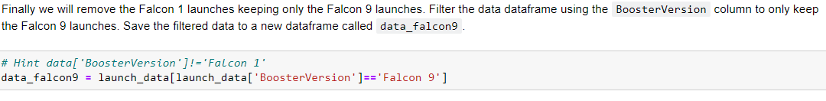
Data Collection - Scraping
Filter the dataframe to only include Falcon 9 launches
The GitHub URL of the completed web scraping notebook

Slide 10
Data Wrangling
Calculate the number of launches on each site
Calculate the number and occurrence of each orbit
Calculate the number and occurence of mission outcome of the orbits
Create a landing outcome label from Outcome column
The GitHub URL of your completed data wrangling related notebooks.

Slide 11
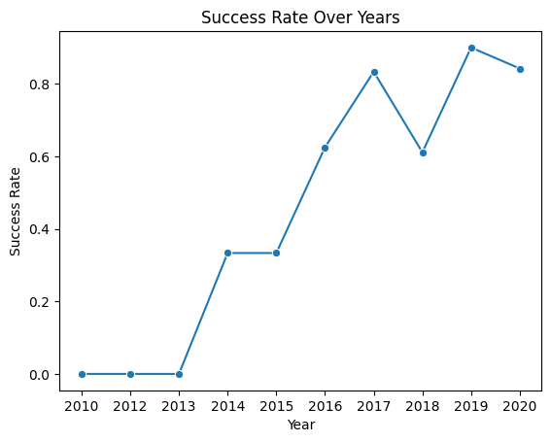
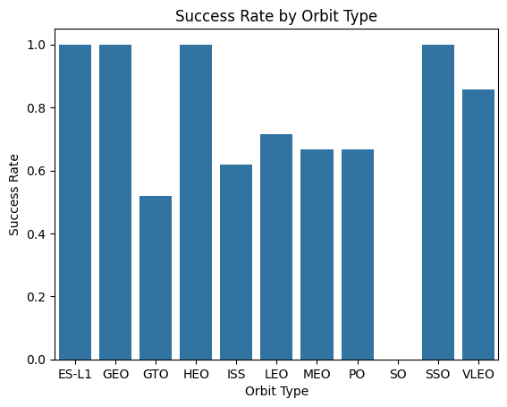
EDA with Data Visualization
We explored the data by visualizing the relationship between flight number and launch Site, payload and launch site, success rate of each orbit type, flight number and orbit type, the launch success yearly trend.
The GitHub URL of your completed EDA with data visualization notebook.

Slide 12
EDA with SQL
We applied EDA with SQL to get insight from the data. We wrote queries to find out for instance:
The names of the unique launch sites in the space mission
5 records where launch sites begin with the string 'CCA’
The total payload mass carried by boosters launched by NASA (CRS)
Average payload mass carried by booster version F9 v1.1
The date when the first succesful landing outcome in ground pad was acheived.
The names of the boosters which have success in drone ship and have payload mass greater than 4000 but less than 6000
The total number of successful and failure mission outcomes
The names of the booster_versions which have carried the maximum payload mass. Use a subquery
The records which will display the month names, failure landing_outcomes in drone ship ,booster versions, launch_site for the months in year 2015.
The count of landing outcomes (such as Failure (drone ship) or Success (ground pad)) between the date 2010-06-04 and 2017-03-20, in descending order
The link to the notebook is: Github URL

Slide 13
Predictive Analysis (Classification)
Models were trained and hyperparameters were selected using the function GridSearchCV.
Accuracy were used as the metric for our model, improved the model using feature engineering and algorithm tuning.
The link to the notebook is: Github URL

Slide 14
Results
Exploratory data analysis results
Interactive analytics demo in screenshots
Predictive analysis results

Slide 15

Section 2

Slide 16
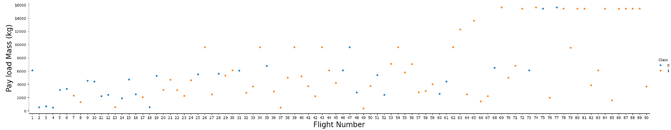
Flight Number vs. Launch Site
We see that as the flight number increases, the first stage is more likely to land successfully. The payload mass also appears to be a factor; even with more massive payloads, the first stage often returns successfully.

Slide 17
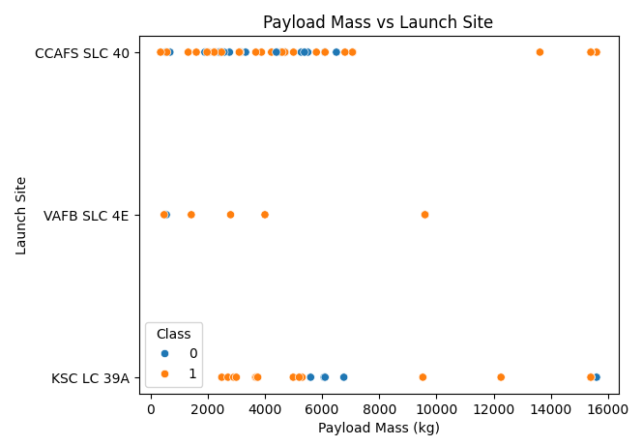
Payload vs. Launch Site
We can observe that the VAFB-SLC launchsite there are no rockets launched for heavypayload mass(greater than 10000).

Slide 18
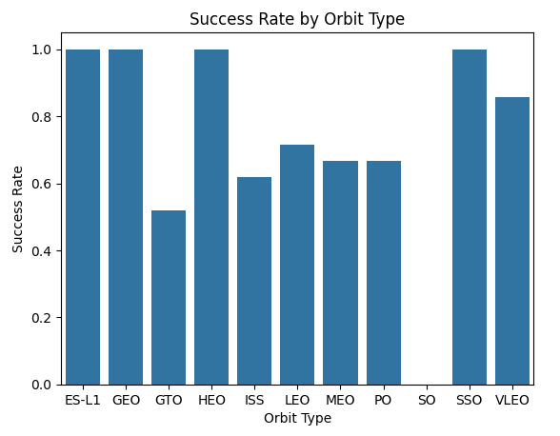
Success Rate vs. Orbit Type
From the plot, we can see that ES-L1, GEO, HEO, SSO, VLEO orbits had the most success rate.

Slide 19
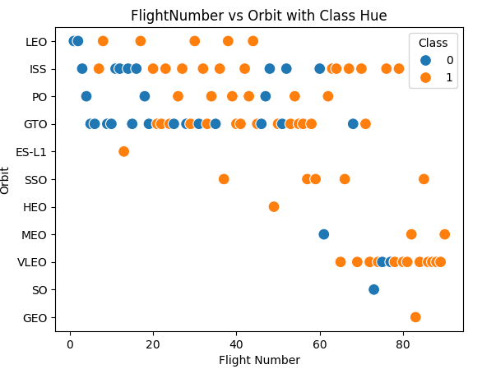
Flight Number vs. Orbit Type
We can observe that in the LEO orbit, success seems to be related to the number of flights. Conversely, in the GTO orbit, there appears to be no relationship between flight number and success.

Slide 20
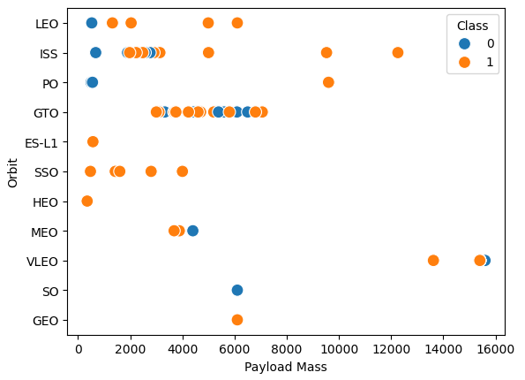
Payload vs. Orbit Type
With heavy payloads the successful landing or positive landing rate are more for Polar, LEO and ISS.
However, for GTO, it's difficult to distinguish between successful and unsuccessful landings as both outcomes are present.

Slide 21
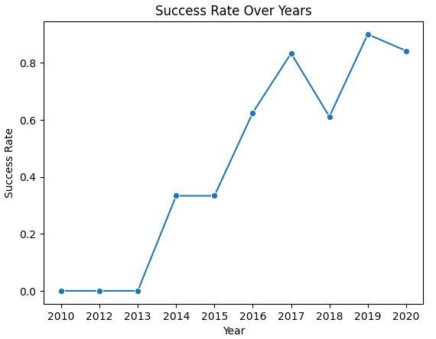
Launch Success Yearly Trend
We can observe that the success rate since 2013 kept increasing till 2017. Eventhough it had dropped between the years 2017 and 2018, in 2019 it reached its peak.

Slide 22
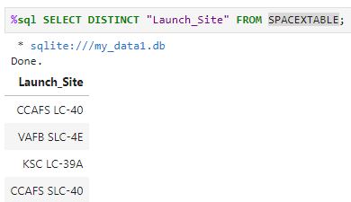
All Launch Site Names
Using DICTINCT key word unique launch sites were displayed.

Slide 23
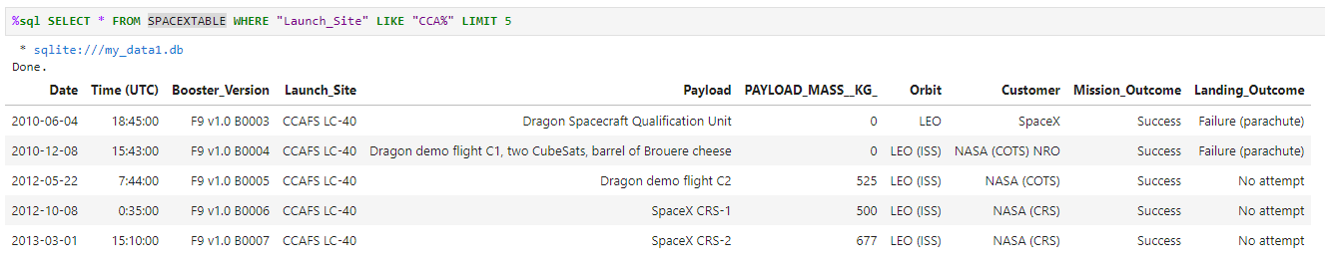
Launch Site Names Begin with 'CCA'
The query above were used to display 5 records whose launch site names begin with ‘CCA’.

Slide 24
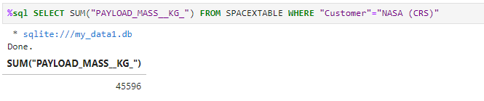
Total Payload Mass
We calculated the total payload carried by boosters from NASA as 45596 using the query below.

Slide 25
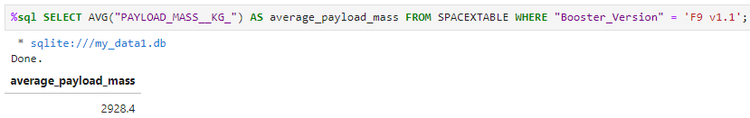
Average Payload Mass by F9 v1.1
Calculated the average payload mass carried by booster version F9 v1.1 and found as 2928.4.

Slide 26
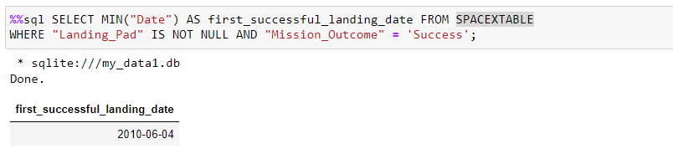
First Successful Ground Landing Date
To find the dates of the first successful landing outcome on ground pad «min» function were used.

Slide 27
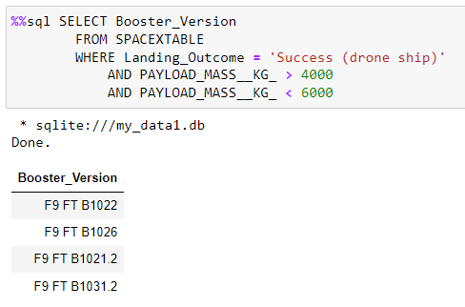
Successful Drone Ship Landing with Payload between 4000 and 6000
Liste the names of boosters which have successfully landed on drone ship and had payload mass greater than 4000 but less than 6000.

Slide 28
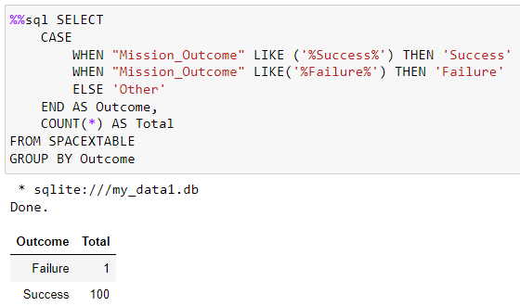
Total Number of Successful and Failure Mission Outcomes
While total number of successful missons is 100, total number of successful missons is 1.

Slide 29
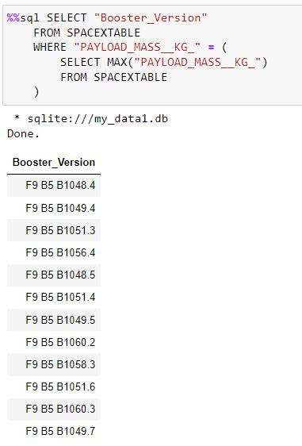
Boosters Carried Maximum Payload
We determined the booster that have carried the maximum payload using a subquery in the WHERE clause and the MAX() function.

Slide 30
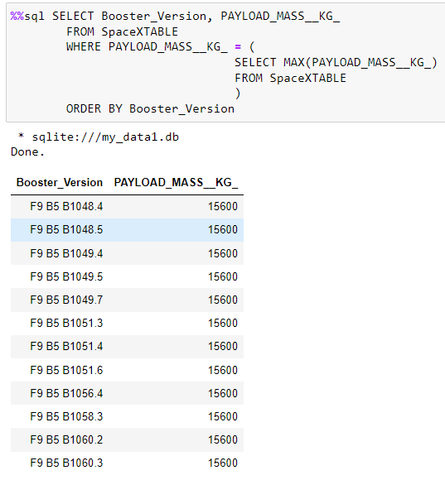
2015 Launch Records
Listed the failed landing_outcomes in drone ship, their booster versions, and launch site names for in year 2015.

Slide 31
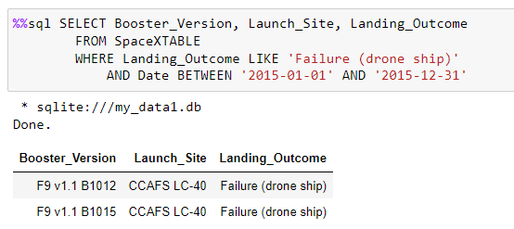
Rank Landing Outcomes Between 2010-06-04 and 2017-03-20
Rank the count of landing outcomes (such as Failure (drone ship) or Success (ground pad)) between the date 2010-06-04 and 2017-03-20, in descending order.

Slide 32

Section 3

Slide 33
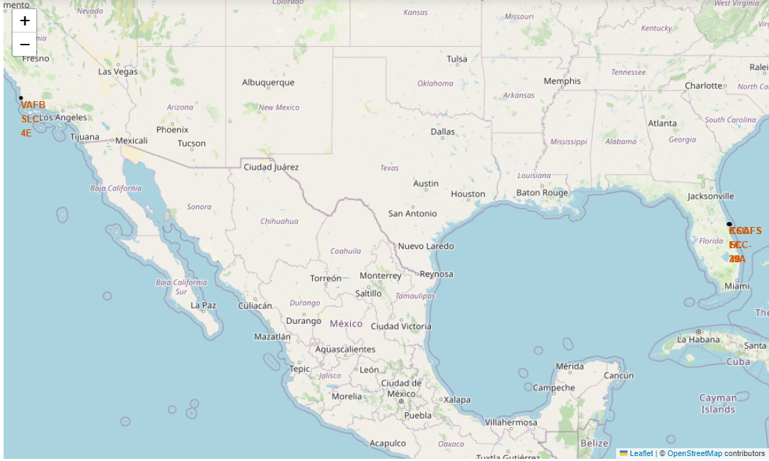
All launch sites global map markers

Slide 34
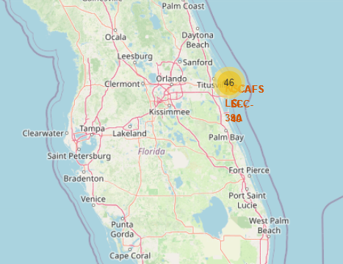
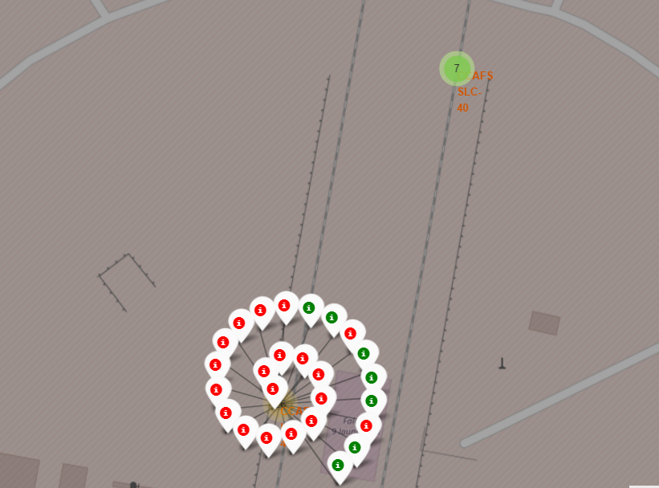
Markers showing launch sites with color labels

Slide 35

Section 5

Slide 36
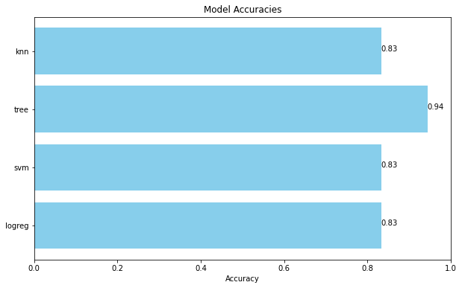
Classification Accuracy
The decision tree classifier is the model with the highest classification accuracy

Slide 37
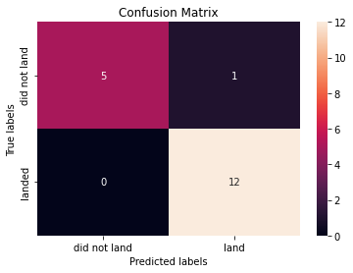
Confusion Matrix
The confusion matrix for the decision tree classifier shows that the classifier can distinguish between the different classes. The major problem is the false positives .i.e., unsuccessful landing marked as successful landing by the classifier.

Slide 38
Conclusions
We can conclude that:
The larger the flight amount at a launch site, the greater the success rate at a launch site.
Launch success rate started to increase in 2013 till 2020.
Orbits ES-L1, GEO, HEO, SSO, VLEO had the most success rate.
KSC LC-39A had the most successful launches of any sites.
The Decision tree classifier is the best machine learning algorithm for this task.

Slide 39


